Slide 1
Research ethics and how health research is reviewed
This presentation has been developed to form part of the lesson ‘Research ethics and how health research gets reviewed’ - www.nuffieldbioethics.org/education

Slide 2
‘Clinical research’ - What is it?
What does research do?
Collects new information
Tests different ideas
Finds out more about a disease and how it is treated
What does it include?
Clinical trials for new medicines
Questionnaires and surveys
Watching people (observing them)

Slide 3
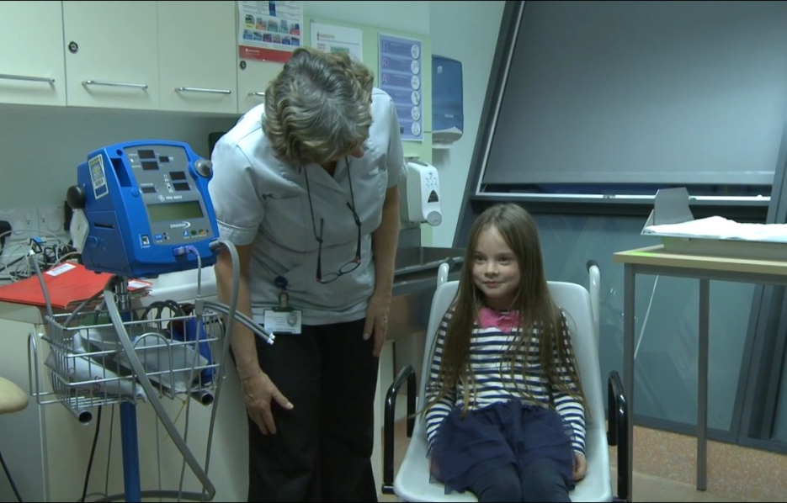
Who does clinical research?
Doctors, nurses, and other people who work in hospitals or clinics
Researchers who work at universities
Scientists who work in laboratories or hospitals

Slide 4
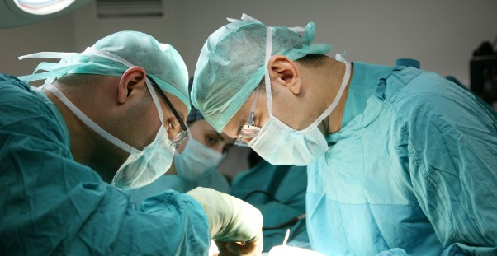
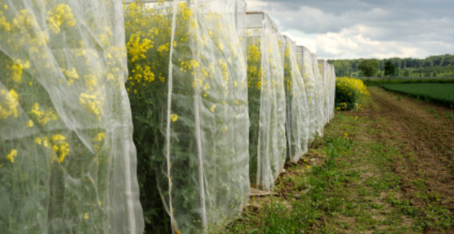
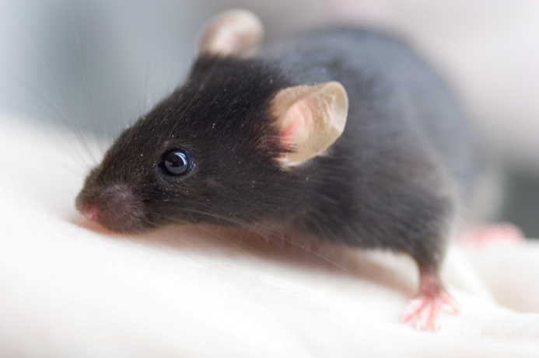
‘Ethics’ and ‘bioethics’ What do they mean?
Ethics: working out the ‘right thing’ to do
Ethical values and principles help us to decide:
If we should behave in a certain way
If something is right or wrong
Bioethics: working out the right ways to use biology or medicine
Helps us to make decisions about how to use biology or medicine
Should we pay people to donate their organs?
Should we plant food crops that have been changed by scientists?
Should animals be tested to help make medicines for people?

Slide 5
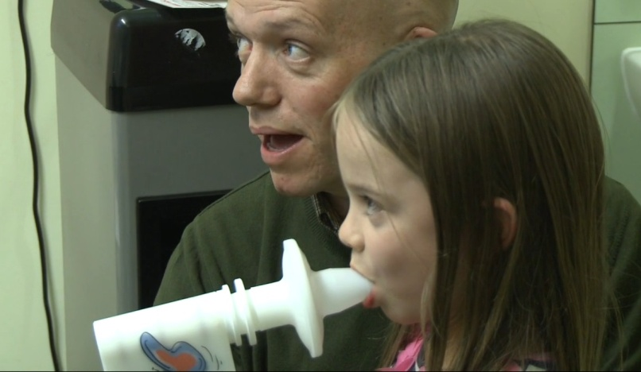
‘Research ethics’?
What are ‘research ethics’?
Values or principles that help researchers ‘work out’ what they can and can’t do
So what would ethical research look like?
Do people know what the research is about?
Do they know enough to decide for themselves whether or not to take part?
Are you sure that people won’t be harmed by the research?
Will the privacy of the people taking part be protected?

Slide 6
What are Research Ethics Committees (RECs)?
Made up of people with different jobs (not just scientists and doctors)
Members will all have different experience

Slide 7
What do RECs do?
Meet to talk about a new study before it goes ahead. They think about:
What is good or not so good about the study
Whether taking part in the study could cause problems for those who take part
Decide whether the research is ethical – for example, is it safe? Will it treat the people who take part with respect?
If it is, then the researchers can go ahead with their study
If it is not, then researchers may be asked to make changes to their research plans

